Slide 1

VEHICLE DETECTOR
| SEARCH MADE EASY |
Batch : D14
Team members:
Kumaran KM (211418104132)
Pradeish C (211418104196)
Naveen SR (211418104172)

Slide 2
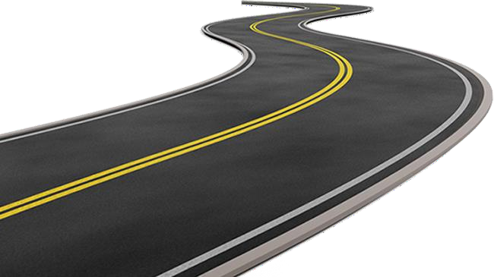
Abstract:
It is an application that helps the owners to track their vehicle when they get lost by using vehicle’s unique information.
Our main goal is to provide the owners with a searching facility across the city using a Public Camera GPS, and mobile capturing technique without raising the complaint to the cop.
The tracking system is done by using captured images by unknown users when they have captured during suspicious activity of that vehicle.

Slide 3






Technical Stack:
Language : Python
Library : Keras, Tensorflow
Database : Excel sheet
Tool : Vs code
Deploy : GitHub Pages

Slide 4
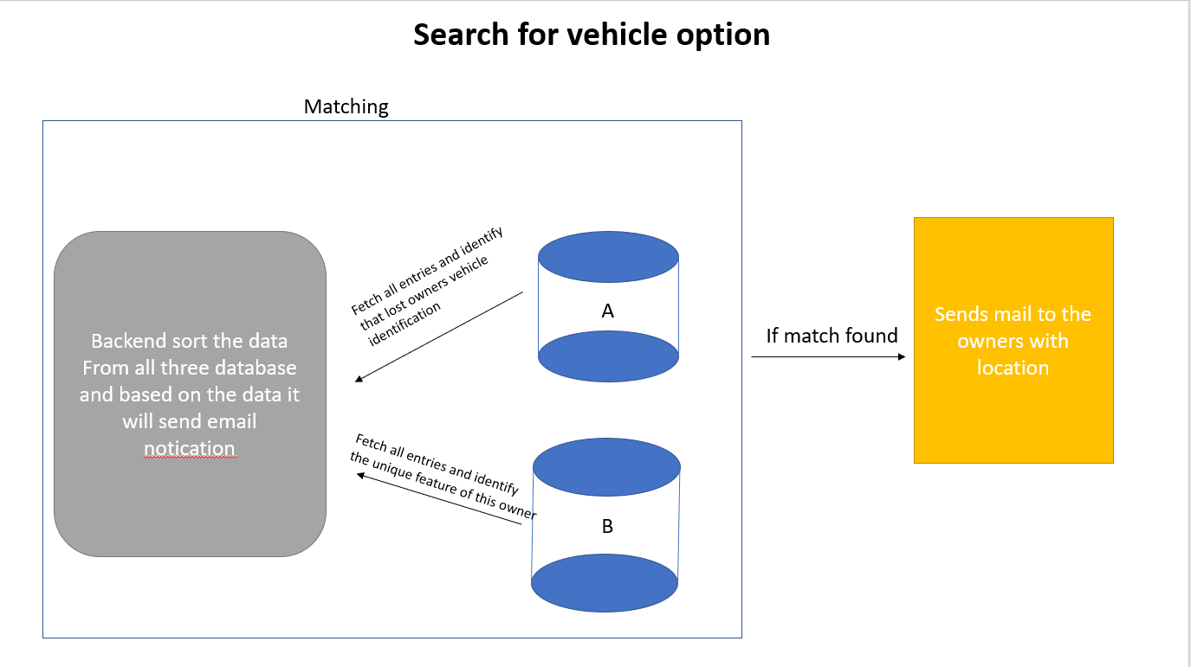
System Architecture

Slide 5

Implementation of the Algorithms / Coding
Step 1: Information are collected by the owners with the help of form and it get stored on registration database
Step 2: Similarly data are collected by the helpers with the help of google form and it get stored on helper database
Step 3: If vehicle gets lost, the owners can ping on our platform and based on the profile the information are collected
Step 4: On the other hand, the collected image from the helpers get processed and by using image recognition technique we will sort the image with some properties

Slide 6

Step 5: The sorted images are updated on helper database with properties like color, license plate, seat color, vehicle type, etc.
Step 6: So we got enough data and it get processed. Now we will move for backend part
Step 7: On the backend, our sever code traverse to all the three database(Register, Helper, Lost) and it will find the matches and common details between these databases
Step 8: Once we have found matches on these database, the email notification with location and captures image will be sent to owners who have lost their vehicle

Slide 7

Implementation
Data that are collected at the time of registration
<form >
<input type="text" placeholder="Full Name" >
<input type="mail" placeholder="Email Id" >
<input type="number" placeholder="Phone Number" >
<input type="text" placeholder="Register number" >
<input type="text" placeholder="Brand name" >
<input type="text" placeholder="Vehicle colour" >
<input type="textbox“ placeholder="Other Information" >
</form>

Slide 8
Data that are collected when user pings for vehicle lost
<form>
<input type="email" placeholder="Enter your Email Address" >
<input type="date" required onclick="datee()">
<button type="submit" onclick="fetchInfo()">Find</button>
</form>
Data that are collected when helper post the images they captured
<form>
<input type=“images" placeholder=“Upload your image" >
<input type=“text" " placeholder=“Enter the location of the image”>
<button type="submit" >Upload</button>
</form>

Slide 9
Code for color detection using python
def getRGB(im):
im = cv2.resize(im, (150,150)) #im.resize((150, 150))
shape = ar.shape
ar = ar.reshape(scipy.product(shape[:2]), shape[2]).astype(float)
codes, dist = scipy.cluster.vq.kmeans(ar, NUM_CLUSTERS
vecs, dist = scipy.cluster.vq.vq(ar, codes)
counts, bins = scipy.histogram(vecs, len(codes))
index_max = scipy.argmax(counts)
peak = codes[index_max]
r,g,b = (int(c) for c in peak)
return r,g,b

Slide 10
Code for traversing the database and finding the match
for b in entries2:
for a in entries1:
if b[0] == a[0]: # matching mail
matchess = []
linkk = []
for c in entries3:
if c[1].casefold() == a[1].casefold(): # matching color
# storing location in list
data_matched = [c[0]]
matchess.append(data_matched)
# storing image links in list
link_matched = [c[2]]
linkk.append(link_matched)
continue

Slide 11
Testing / Performance Analysis
S. No | Test Case | Test Steps | Test Results
1 | Verify Login functionalities with the correct condition | Enter mail id: abc@sample.com Enter password: xyz | Redirect to owners page
2 | Verify Login functionalities with the wrong condition | Enter mail id: abc@sample.com Enter password: Empty | Password not found stay in the same owner page

Slide 12
S. No | Test Case | Test Steps | Test Results
3 | Sending Images to the platform | Send photos here: sample.jpg Send Location: Poonamale, Chennai | Redirect to helper page
4 | Sending Images to the platform without proper data | Send photos here: sample.jpg Send Location: Empty | Location not found. Staying the same page

Slide 13





Requirement Analysis:
Hardware:
Desktop or Mobile
Internet Connection
Software:
Any advance browser
And any operating system

Slide 14
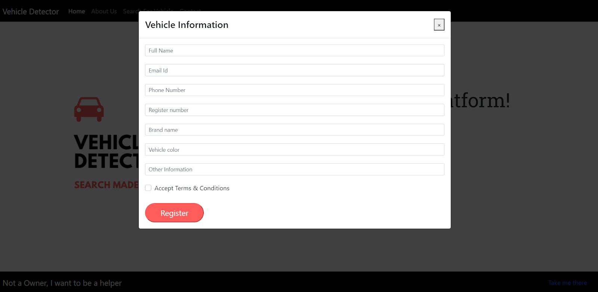
Output window

Slide 15
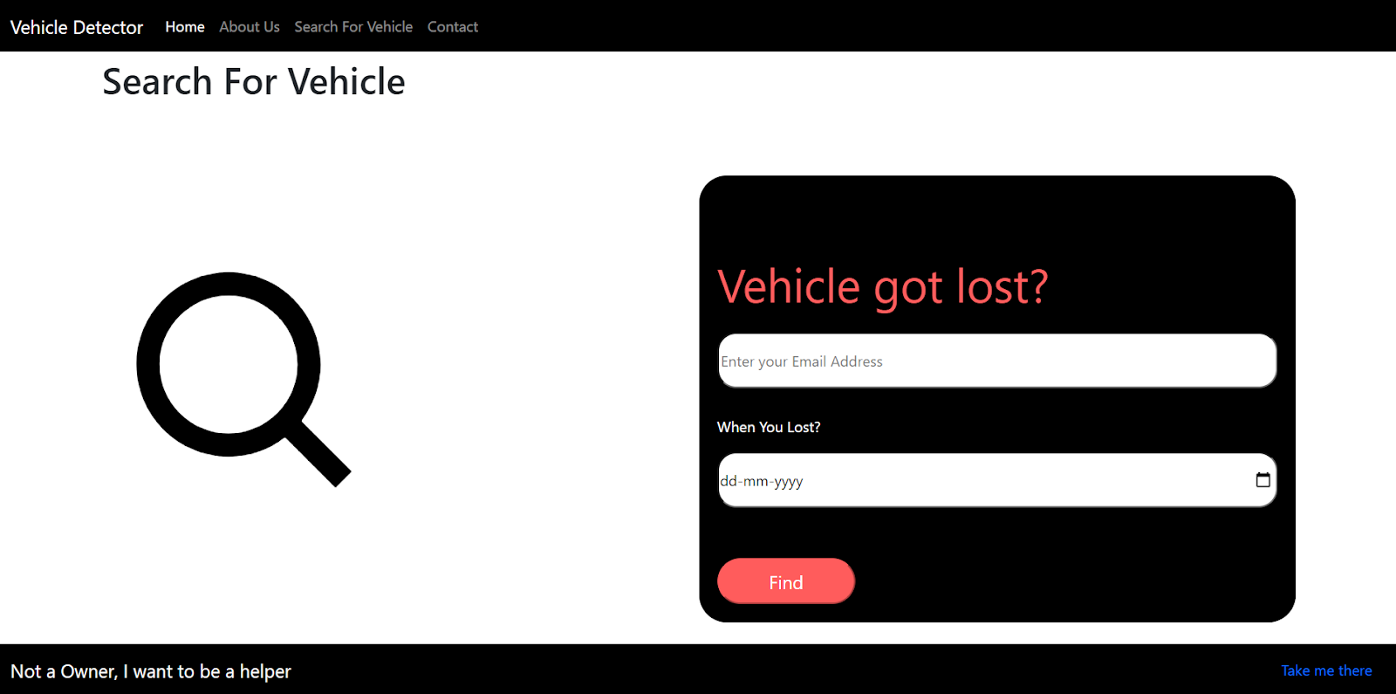

Slide 16
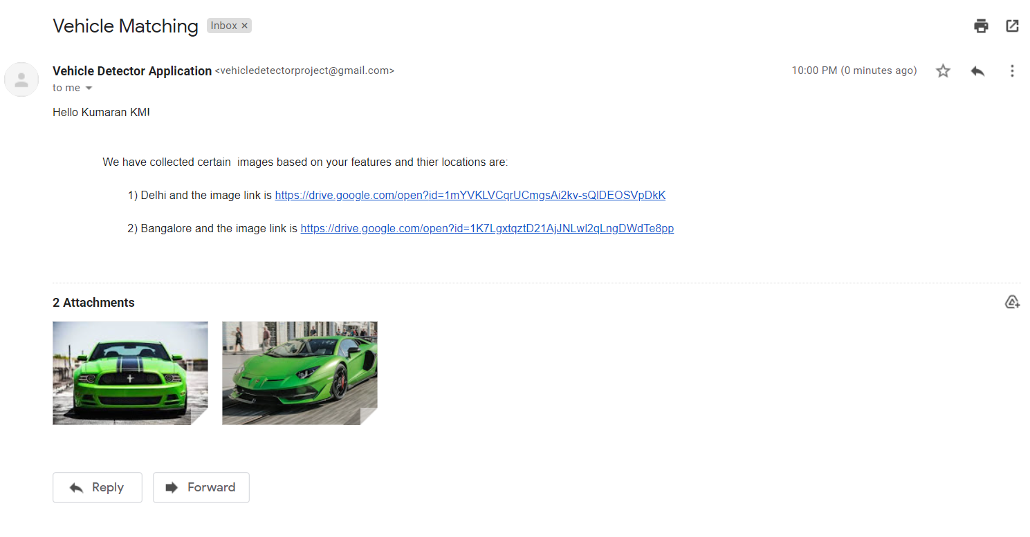

Slide 17

Conclusion & Future Enhancements
The above-proposed system has provided comprehensive methods
and an overview of the application that detects vehicles with the
helping image capturing technique.
If there are any server issues successes or fraudulent information,
then this whole system is taken care of by the admin.
Hence this platform made the owners find the vehicle without
any police complaints.

Slide 18

First, we are going to import mongo as a cloud database(Atlas) for this project so that we can add or edit enormous amounts of data easily and quickly.
Then we would like to do web hosting via a digital ocean network instead of using GitHub pages and we would like to buy the domain for our project
Then we would like to feed more datasets into our machine learning framework and add additional features like seat identifying, car steering color, scratch features, etc for detecting a vehicle.

Slide 19

Project Url:
https://projectdetector.github.io/FrontEndCode/
Email us:
vehicledetectorproject@gmail.com

